Slide 1
Data Analysis Level 4 Training
Introduction to Python Programming Language
Notes:
Data Analyst Level 4 Apprenticeship

Slide 2
Aims and objectives
To understand:
Reasons to use Python
Python in the Cloud
Reasons to use Jupyter Notebook IDE
Python Operators and Variables
Python data types (data structures)
Python Programming constructs
Accessing help in Python Jupyter notebook
Python Libraries for Data Science
Pandas library deep dive
Pandas Subsetting or Slicing techniques
Working with missing data
Connecting to SQL Server
Page 2

Slide 3


Reasons to use Python
Python is an open-source general-purpose coding language, created by Guido van Rossum and released in 1991. Python is a beginner-friendly language - its syntax uses English keywords that makes it easy for anyone to understand.
Out of the box, Python’s standard library offers a wide range of facilities for:
String/text processing functionalities
I/O (input/output) functionalities
Numeric and mathematical functionalities
For more info please refer to this link: https://docs.python.org/3/library/
Python also provides access to powerful data modelling capabilities through vast array of packages: NumPy, pandas, matplotlib, SciPy, scikit-learn, statsmodels to name a few.
Page 3

Slide 4

Python in the cloud: Google Colab
Colaboratory, or “Colab” for short, is a product from Google Research.
Colab allows anybody to write and execute arbitrary python code through the browser, and is especially well suited to machine learning, data analysis and education.
Available through https://colab.research.google.com/
Page 4

Slide 5
Jupyter Notebook IDE
Page 5

Slide 6

Reasons to use Jupyter Notebook IDE
The Jupyter Notebook is an open-source, easy to use web application that allows you to create and share documents that contain live code, equations, visualizations and narrative text.
Uses include: data cleaning and transformation, numerical simulation, statistical modeling, data visualization, machine learning, and much more.
Available through:
https://www.anaconda.com/products/individual
https://jupyter.org/install
Page 6

Slide 7
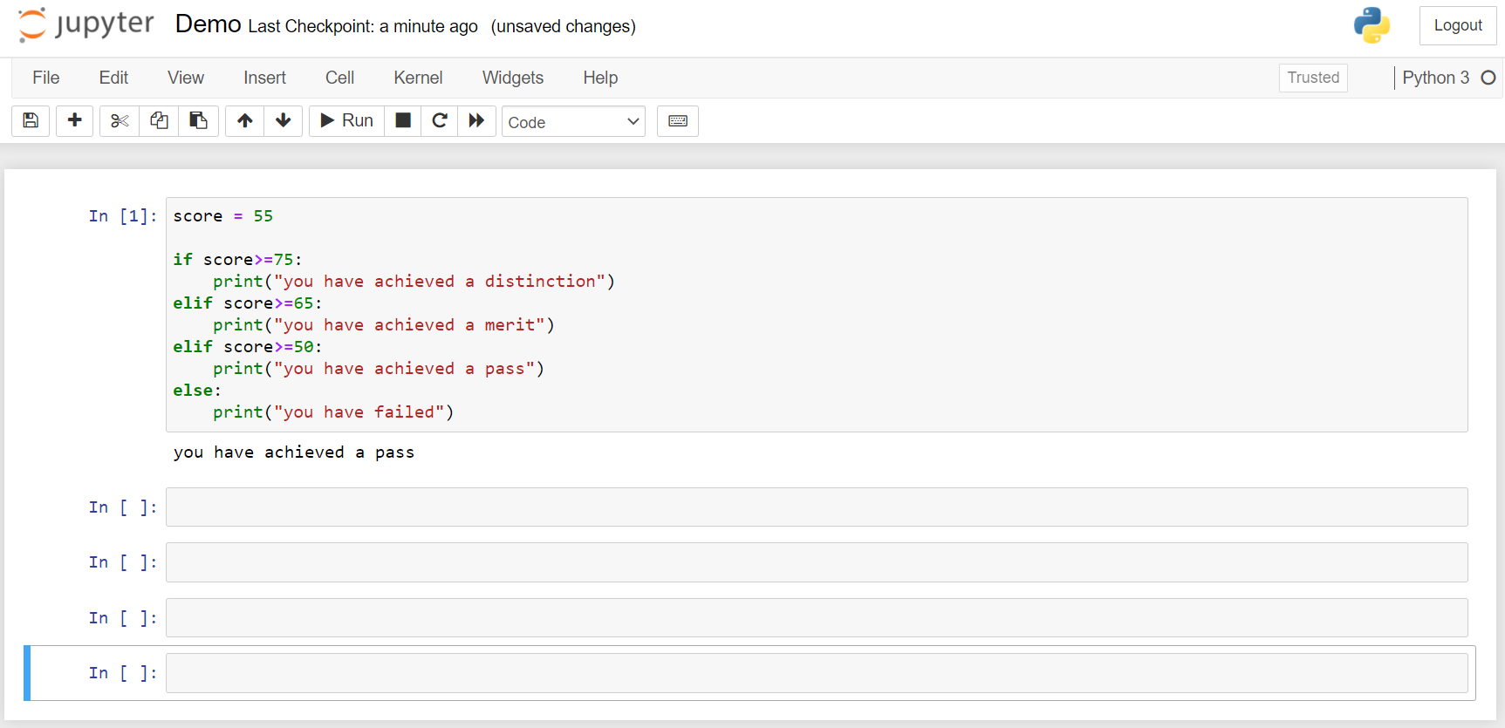
Using Jupyter Notebook Graphical User Interface
To execute or run a code cell
press the Run button
press Shift + Enter
press CTRL+ Enter
Notebook
Cells
Results are displayed here
Page 7

Slide 8
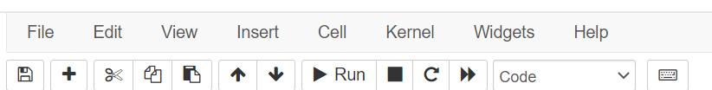
Jupyter Notebook Toolbar
Cut, copy
paste
Move cell
Run
cell
Reset
cell
Change
cell type
Save
New
Cell
Stop
cell
execution

Slide 9
Python
Operators and Variables
Page 9

Slide 10
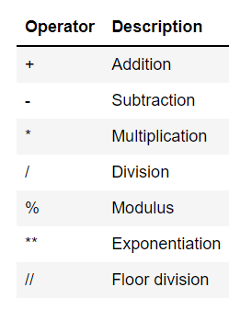
Python Arithmetic Operators
Common Arithmetic operators supported by python:
Page 10

Slide 11
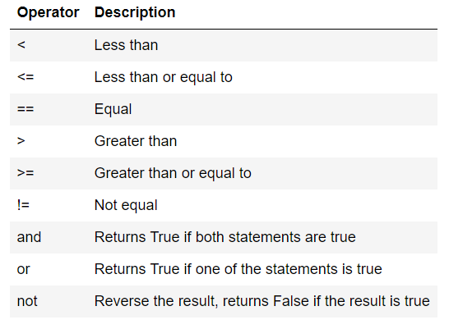
Python Logical Operators
In python logical operators are used while constructing conditional statements.
The result of a Logical operation is always a Ture or False
Page 11

Slide 12
Python Variables
In python logical operators are used while constructing conditional statements.
The result of a Logical operation is always a Ture or False
Page 12

Slide 13
Python data types
(data structures)
Page 13

Slide 14
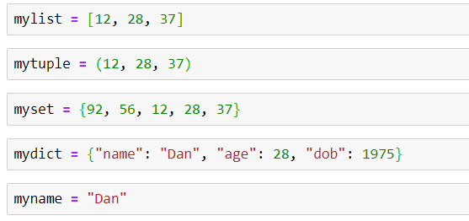
Python data types (data structures)
Every data value in Python has a data type. Every data value/variable in python is an object. You can use the type() function to determine which data type a data value or a variable belongs to.
Data structure is a collection of data types. Data types can be string, integer, float, boolean and so on. Data structure is a specific way of storing and organising these data types in memory.
The following are the data structures in Python that are mainly used during data science-related projects. In Python, the term data type and data structures are used interchangeably.
Lists
Tuples
Sets
Dictionaries
String
Page 14

Slide 15
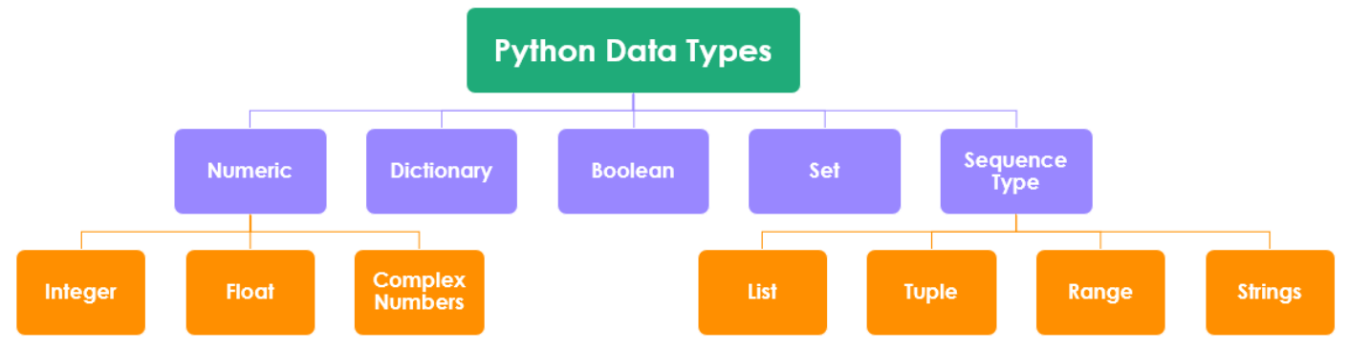
Python data types (data structures)
Page 15

Slide 16
Python lists
List is one of the most versatile and frequently used data types used in Python. It is a mutable(changeable) ordered sequence of items.
In Python, a list is created by placing all the items inside square brackets [ ], separated by commas. It can contain any number of items with different data types (integer, float, string etc.).
Page 16

Slide 17
Python tuples
Tuple is similar to a list in terms of indexing. It is an immutable ordered sequence of items, meaning items inside a Tuple cannot be changed/updated.
In Python, a tuple is created by placing all the items inside parentheses ( ), separated by commas. A tuple can contain any number of items with different data types (integer, float, string etc.).
Page 17

Slide 18
Python sets
A set is an unordered and unindexed collection of items, without any duplicates - every item is unique. It is created by placing all the items/elements inside curly braces { }, separated by commas.
It is also possible to use the set() constructor to make a set. This is useful when converting a list/tuple to a set.
Sets can also be used to perform mathematical set operations, like union, intersection, etc. They can contain any number of items with different data types (integer, float, string, etc..)
Sets are mutable(changeable).
Page 18
Notes:
1st hotspot in sets

Slide 19
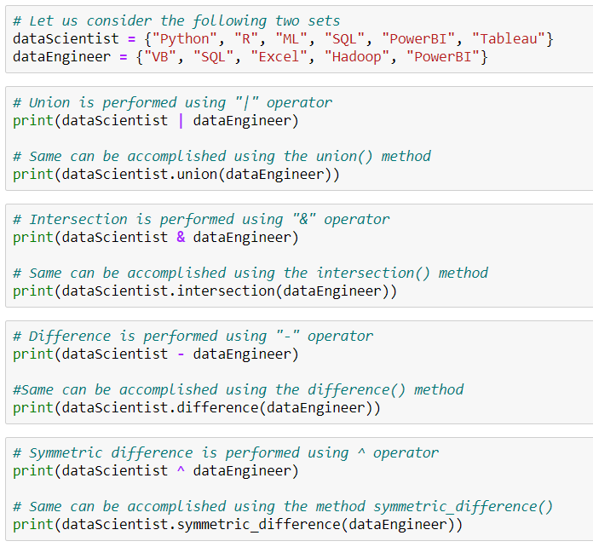
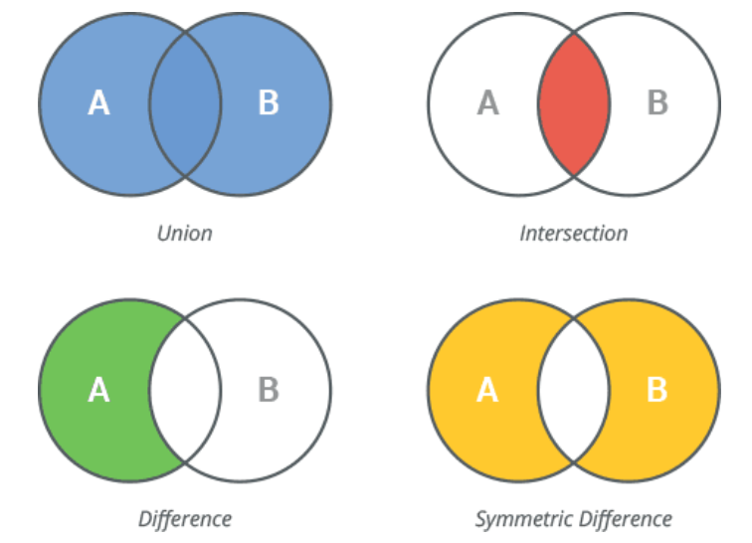
Python set operations
The union operator '|' combines two sets to form a new one containing items from both.
The intersection operator '&' gets items common only to both.
The difference operator '-' gets items in the first set but not in the second.
The symmetric difference operator '^' gets items in either set, but not both (excluding the intersection).
Page 19
Notes:
(with slide 18) This is how data is combined in Python
Image
This is how it would be written in Python
1st sets out the two data sets they are working with.
Intro image – this is how the script is written in python for a union operator

Slide 20
Python dictionary
A dictionary is a collection of items which is unordered, mutable and indexed. It is created by placing all items/elements inside curly braces { }, separated by commas, with each item in a dictionary having a key/value pair.
We can also create a dictionary using the built-in dict() function.
An item has a key(unique index) and a corresponding value that is expressed as a pair (key: value).
Page 20

Slide 21
Python strings
Strings are arrays of bytes representing Unicode characters.
A string is a collection of one or more characters put inside quotes. In Python, any one/single character is a string of length one. It is represented by str class.
Page 21
Notes:
String hotspot 1

Slide 22
Python built-in open function to read string
Page 22

Slide 23
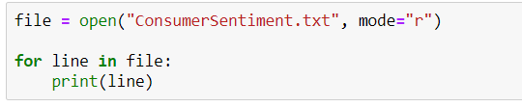
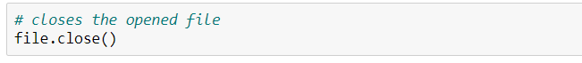
Python built-in open() function to read string
The open() built-in function is used to open files in your system. It takes two arguments, the name of the file and the mode.
The filename is the name of the file to be opened. The mode indicates how the file is going to be opened - 'r' for reading, 'w' for writing and 'a' for appending.
The default mode for opening a file is 'r'.
Page 23
Notes:
Make this a hotspot box at the bottom of the string box

Slide 24
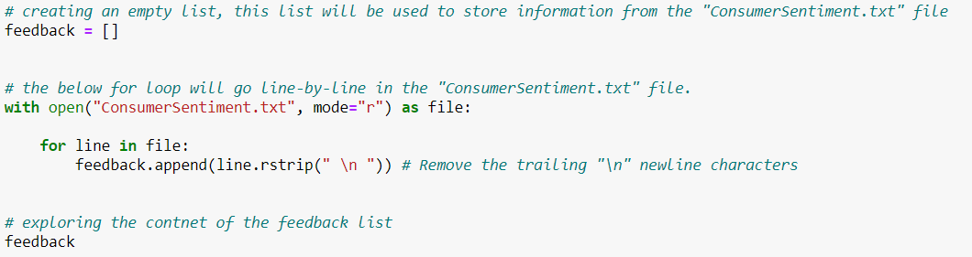
With open() function (string)
With the 'With' statement, you get better exceptions handling.
In addition to this, it will automatically close the file. So there’s no need to execute file.close().
Page 24

Slide 25
Python
Programming constructs
Page 25

Slide 26
Programming constructs
Programming Constructs are used to control the order in which instructions are executed. In programming languages such as SQL, R, Python the expression which translates to an instruction is called as a programming statement.
All programming languages support the following programming constructs. One or more of these programming constructs can be used repeatedly based on the complexity of the program.
Sequencing: When your code runs from top to bottom, one line at a time. It will start from line 1, then execute line 2, 3 etc until the end of your program.​
​Selection: When you would like to run code conditionally. Here is where you’ll use ‘CASE’ and ‘IF’ statements.
​ Iteration: When you want to execute the same lines of code several times. There are three types of loops to achieve this: ‘FOR’ loops, ‘WHILE’ loops and ‘REPEAT UNTIL’ loops. This prevents repetition and reduces the length of your code.
Page 26
Notes:
Carousel?

Slide 27
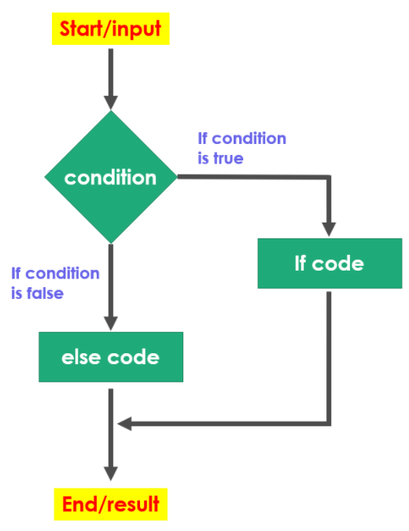
Python If/else statements (conditional statements)
If/else statements help us to run a particular code only when a certain condition is satisfied
If/else statements make use of logical operator while defining the condition
if/else logic can be extend by using nested if conditions
Page 27

Slide 28
Python Loops
In general loops are used to execute statements sequentially. Loops are useful when you want to iterate through lists, tuples, dictionaries, sets, or strings and perform calculations
There are two types of loops in Python
For Loop
While Loop
Page 28

Slide 29
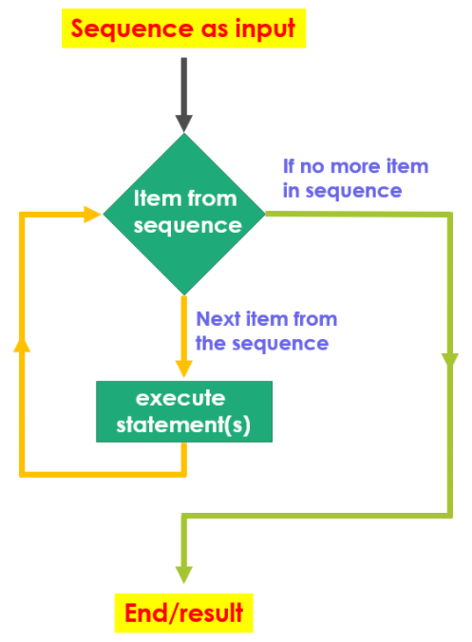
Python - For Loop
A for loop is used for iterating through a sequence (such list, tuple, dictionary, set, or a string)
With the for loop we can execute a set of statements, once for each item in a list, tuple, set etc.
Page 29

Slide 30
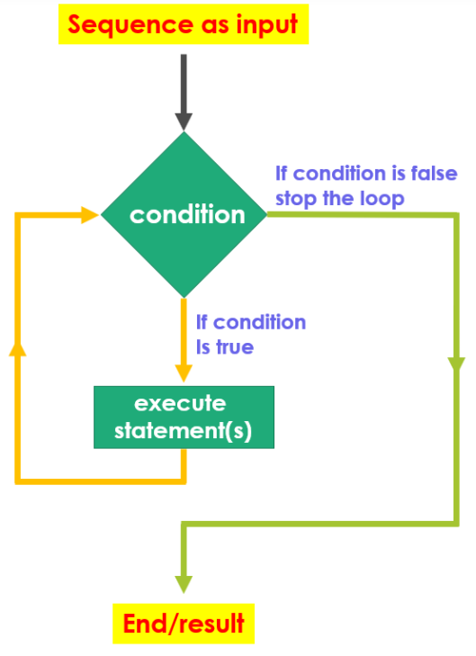
Python - While Loop
While loop we can execute set of statements as long as the specified condition is true
Page 30

Slide 31
Accessing help in Python Jupyter notebook
Below are three techniques that can be used to access help documentation in python.
Place your mouse key anywhere within the body of the function. Hold down the SHIFT key, and then press the TAB key. To access extended help, repeat the above step, but this time press the TAB key twice.
If you need help with a particular function, type the function name into a cell within Python followed by a question mark. For example, if you’d like help with using the round() function, you’d type round?
Accessing help using help() function
Use Python’s built-in help() function to access help documentation about all python objects. Such as, data-types and functions. The general syntax for help is: help(object-name). For example, you would use:
Data-type help à help(list_name)
Function help à help(round)
Module help à help(math)
Page 31

Slide 32
Python Libraries
for Data Science
Page 32

Slide 33
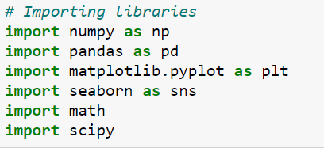
Loading Python Libraries
To make use of the functions in a library, you’ll need to import with an import statement. An import statement is made up of the “import” keyword along with the name of the library, “as” keyword can be used to assign a alias.
Page 33

Slide 34
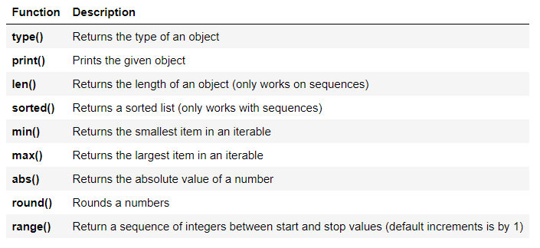
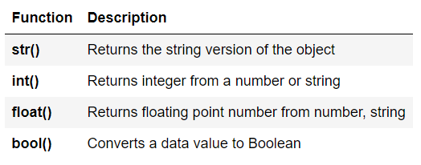
Python Built-in Functions - standard library
Out of the box (without any importing) python’s standard library offers a wide range of facilities for:
String/text processing functionalities
I/O (input/output) functionalities
Numeric and mathematical functionalities
For more info please refer to this link: https://docs.python.org/3/library/
Python has several built-in functions that its standard library covers.
Page 34

Slide 35
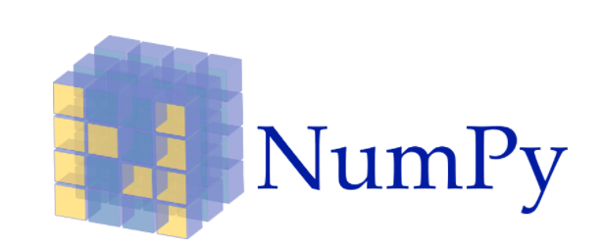
NumPy
NumPy stands for Numerical Python. NumPy is the core library for scientific computing in Python.
NumPy provides multidimensional array objects, and tools for working with these arrays, Many other python libraries are built on NumPy.
Link: http://www.numpy.org/
Page 35

Slide 36
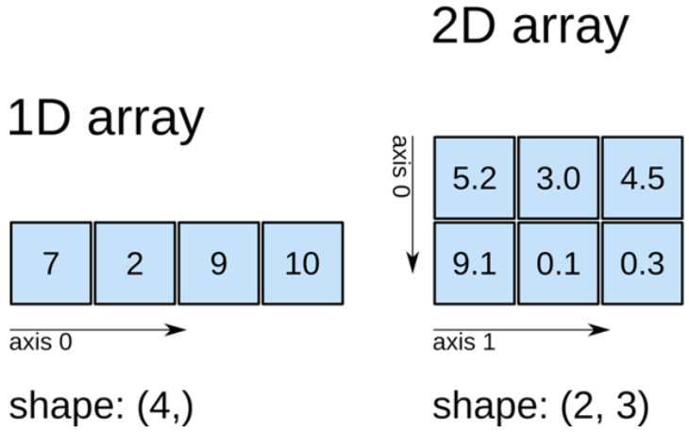
NumPy "Array" data object
NumPy provide array data objects (data structure) that are up to 50x faster than Python lists. NumPy arrays are called as "ndarray" (n dimensional array)
Arrays are homogeneous multidimensional structures. Arrays are grid of values, sharing the same data type, indexed by a tuple of non-negative integers. NumPy dimensions are called axes
Page 36

Slide 37

Pandas
Pandas is a high-level data manipulation library. It is built on the NumPy package and provides two valuable data structures: Series and DataFrame
DataFrame allow you to store and manipulate tabular data in rows and columns
Link: http://pandas.pydata.org/
Page 37

Slide 38

SciPy
SciPy (pronounced “Sigh Pie”) is a of open-source software for mathematics, science, and engineering that is built on Numpy. SciPy stands for Scientific Python.
SciPy has optimised and added functions that are frequently used in NumPy and Data Science.
Link: https://www.scipy.org/scipylib/
Page 38

Slide 39

Scikit-learn
Scikit-learn is a free machine learning library that provides many unsupervised and supervised learning algorithms for classification, regression and clustering.
Built on NumPy, SciPy, and matplotlib.
Link: http://scikit-learn.org/
Page 39

Slide 40

matplotlib
Matplotlib is a open source, cross-platform, data visualization and graphical plotting library for Python
Link: https://matplotlib.org/
Page 40

Slide 41
Pandas library
deep dive
Page 41

Slide 42
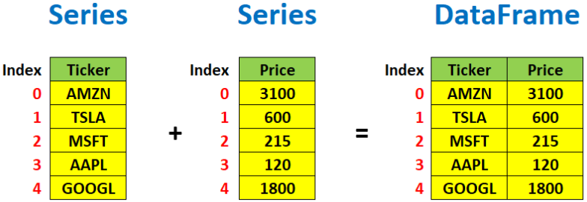
Pandas data structures
Pandas Series is a one-dimensional labelled array capable of holding any data type with axis labels or index. An example of a Series object is one column from a DataFrame. Indexing in a panda’s series starts from 0
Pandas DataFrame is a 2-dimensional labelled data structure with columns of potentially different types. You can think of it like a spreadsheet or SQL table, or a dictionary of Series objects. It is generally the most commonly used pandas’ object. Like Series, DataFrame accepts many different kinds of inputs. Indexing in a panda DataFrame starts from 0 (for both rows and columns)
Page 42

Slide 43
Pandas data frame data types
The following methods can be used to explore pandas data frames.
Pandas Type | Native Python Type | Description
object | string | The most general dtype. Will be assigned to your column if column has mixed types (numbers and strings).
int64 | int | Numeric characters. 64 refers to the memory allocated to hold this character.
float64 | float | Numeric characters with decimals. If a column contains numbers and NaNs(see below), pandas will default to float64, in case your missing value has a decimal.
datetime64, timedelta[ns] | N/A (but see the datetime module in Python’s standard library) | Values meant to hold time data. Look into these for time series experiments.
Page 43

Slide 44
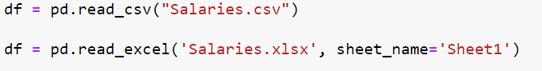
Reading data using pandas
There is a number of pandas commands to read data files, most popular being CSV and EXCEL.
Page 44

Slide 45
Pandas data frame methods
The following methods can be used to explore pandas data frames.
df.method() | description
head( [n] ), tail( [n] ) | first/last n rows
describe() | generate descriptive statistics (for numeric columns only)
max(), min() | return max/min values for all numeric columns
mean(), median() | return mean/median values for all numeric columns
std() | standard deviation
sample([n]) | returns a random sample of the data frame
dropna() | drop all the records with missing values
groupby() | group data based on some criteria and calculate summary statistics
Page 45

Slide 46
Pandas data frame attributes
The following methods can be used to explore pandas data frames.
df.attribute | description
dtypes | list the types of the columns
columns | list the column names
axes | list the row labels and column names
ndim | number of dimensions
size | number of elements
shape | return a tuple representing the dimensionality
values | numpy representation of the data
Page 46

Slide 47
Pandas
Subsetting or Slicing
techniques
Page 47

Slide 48
Pandas Subsetting or Slicing techniques
We will be exploring four slicing techniques:
Using square brackets []
Using logical (boolean) expressions method
Using loc[ ] method
Using iloc[ ] method
Page 48

Slide 49
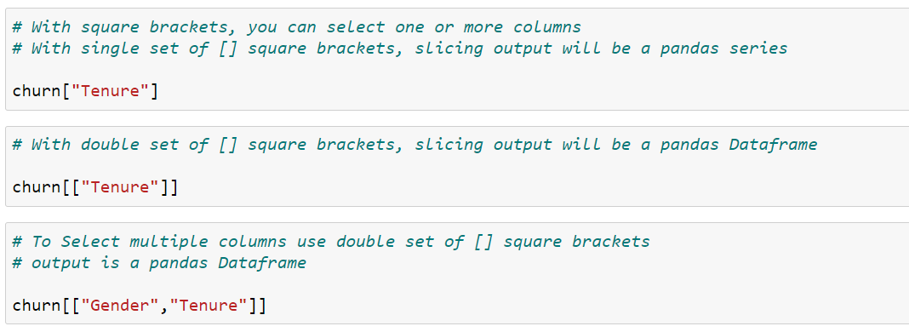
1. Using square brackets [ ]
Page 49

Slide 50
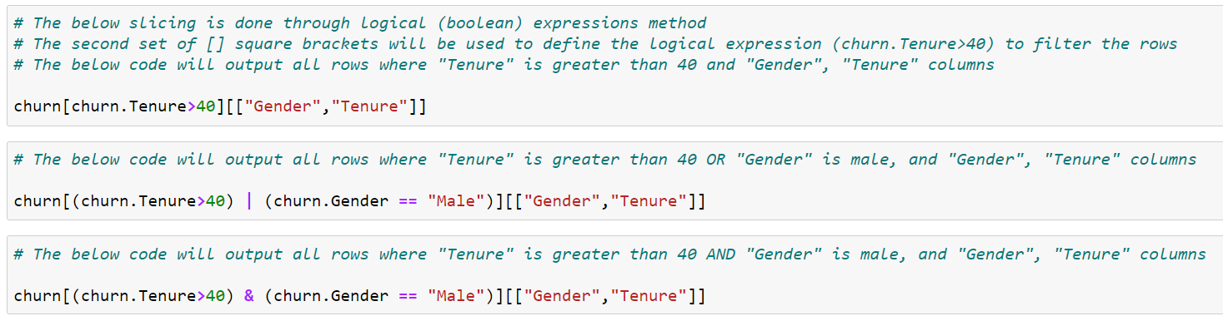
2. Using logical (boolean) expressions method
Page 50

Slide 51
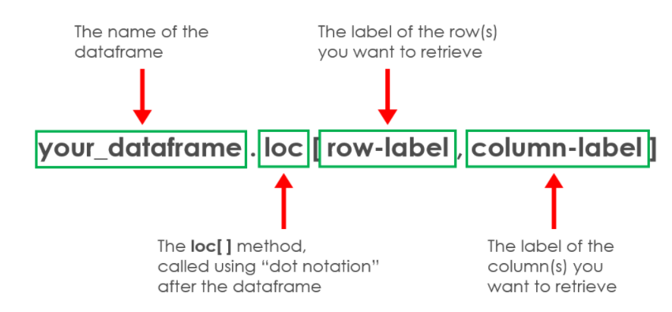
3. Using loc[ ] method
The pandas attribute .loc will allow you to select rows and columns in the following fasion
Page 51

Slide 52
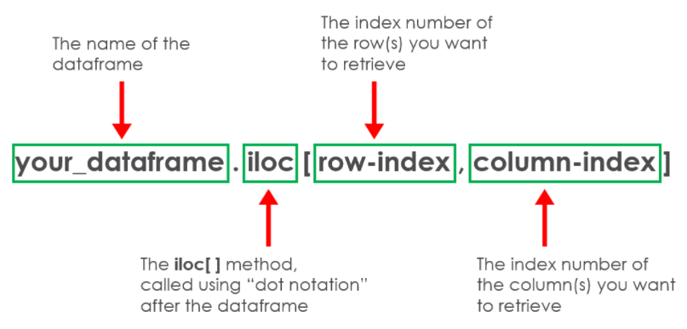
4. Using iloc[ ] method
The pandas attribute .iloc will allow you to select rows and columns in the following fasion
Page 52

Slide 53
Working with missing data
Page 53

Slide 54
Working with missing data
Missing Data can occur when no information is provided.
In Pandas missing data is represented by two value: None and NaN (an acronym for Not a Number), None and NaN as essentially interchangeable for indicating missing or null values.
There are several useful functions for detecting, removing, and replacing null values in Pandas DataFrame. These function can also be used in Pandas Series:
isnull()
notnull()
dropna()
fillna()
replace()
interpolate()
Page 54

Slide 55
Connecting to a
Microsoft SQL Server
Page 55

Slide 56
Using “pyodbc” to connect to MS-SQL
Pyodbc is an open-source Python library that makes accessing ODBC databases such a Microsoft SQL sever possible. Once the pyodbc connection has been established, you can execute SQL statements to extract data from a database.
There are seven main settings needed to make a connection:
1. Driver - is called as SQL Server 2019 connection string
2. Server - A network path to the database server
3. Database - The name of the database
4. UID - The user's network ID or sql server local account name
5. PWD - The account's password
6. Port - This should be set to 1433
7. Trusted_connection - This should be always used while connecting to a local instance of MSSQL using Windows credentials
Page 56

Slide 57
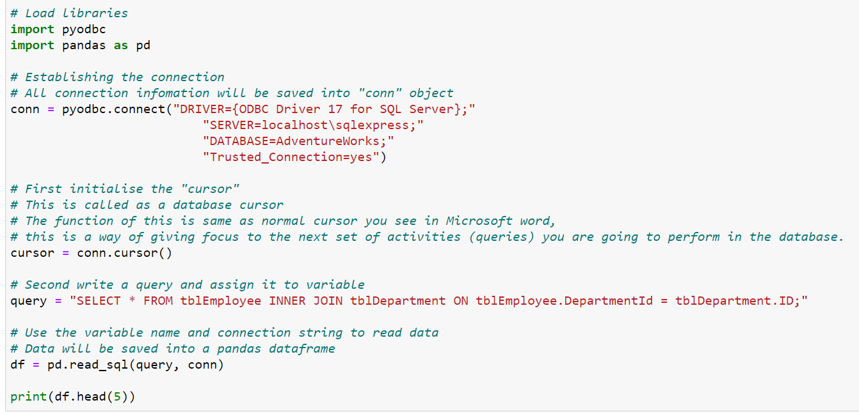
Using “pyodbc” to connect to MS-SQL
Page 57

Slide 58
Questions?
Page 58

Slide 59
Summary
Key points covered in this module:
Reasons to use Python
Python in the Cloud
Reasons to use Jupyter Notebook IDE
Python Operators and Variables
Python data types (data structures)
Python Programming constructs
Accessing help in Python Jupyter notebook
Python Libraries for Data Science
Pandas library deep dive
Pandas Subsetting or Slicing techniques
Working with missing data
Connecting to SQL Server
Page 59

Slide 60
Thank you
careers@archapprentices.co.uk
www.archapprentices.co.uk
Page 60

